Slide 1
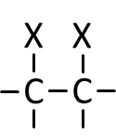
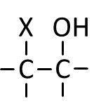
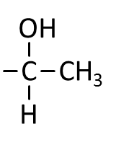
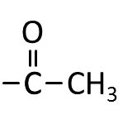
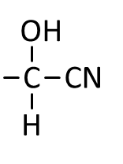









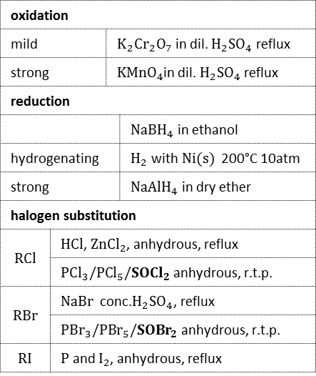























`
halogen substitution [($H{\ddot{X}}^{δ−}$)]
ALCOHOL
r.t.p. [condensation/nucleophilic acyl substitution$)$]
oxidation
mild |  | $K_{2}{Cr}_{2}O_{7}$ in dil. $H_{2}{SO}_{4}$ reflux
strong |  | $KMnO_{4}$in dil. $H_{2}{SO}_{4}$ reflux
reduction
 |  |  | $NaBH_{4}$ in ethanol
hydrogenating |  |  | $H_{2}$ with$Ni(s)$ 200°C 10atm
strong |  |  | $NaAlH_{4}$ in dry ether
halogen substitution
$$RCl$$ | $HCl$, $ZnCl_{2}$, anhydrous, reflux
 | $PCl_{3}/P{Cl}_{5}/SOCl_{2}$ anhydrous, r.t.p.
$$RBr$$ | $NaBr$ conc.$H_{2}{SO}_{4}$, reflux
 | $P{Br}_{3}/P{Br}_{5}/SO{Br}_{2}$ anhydrous, r.t.p.
$$RI$$ | $P$ and $I_{2}$, anhydrous, reflux
C
X
dil.$NaOH$ reflux [$({\ddot{O}H}^{−})$]
strong
minor
major
C
O
H
dil. $H_{2}{SO}_{4}$/$NaOH$ reflux 180°C
O
HALOALKANE
$Na$(s)
C
O
C
dil. $KMnO_{4}$ in $NaOH$ (aq.)
cold
C
O⁻
ESTER
excess conc. $H_{2}{SO}_{4}$reflux 180°C conc. $H_{3}{PO}_{4}$ 200-250°C ${Al}_{2}O_{3}$ 350°C
$H_{2}O$ conc. $H_{3}{PO}_{4}$300°C 70atm $\left[\left({}_{}^{δ+}HOH\right)\right]$
ALKOXIDE
conc. $H_{2}{SO}_{4}$reflux 180°C [condensation]
$X_{2}$in $C{Cl}_{4}$ r.t.p. dark $\left[\left({}_{}^{δ+}X−X\right)\right]$
$X_{2}$(aq.) dark $\left[\left({}_{}^{δ+}X−X\right)\right]$
O
2º
1º
$HX$ (g) r.t.p. $\left[\left({}_{}^{δ+}HX\right)\right]$
base
C
Cl
conc. $NaOH$ in ethanol reflux
CARBOXYLATE
ACYL CHLORIDE
O
C
C
C
O⁻
acid
$$H_{2}O$$
r.t.p.
$$\left[\left(H\ddot{O}H\right)\right]$$
$HCl$, $ZnCl_{2}$ heat under reflux
$PCl_{3}/PCl_{5}/SOCl_{2}$ anhydrous, r.t.p.
$X_{2}$ UV [Free radical substitution]
ALKENE
for:
O
hydrogenating
$Pt/Pd$ [adsorption]
mild (warm & distil)
O
thermal: 800°C 70atm
catalytic:
500°C 2atm $$Al_{2}O_{3}, {SiO}_{2}$$
reforming: 500°C 40atm $$Pt,Al_{2}O_{3}$$
yellow ppt of ${CHI}_{3}$
$I_{2}$ with $NaOH$ (aq.), warm
strong
C
O
H
dil. $H_{2}{SO}_{4}$/$NaOH$ reflux 180°C
r.t.p. [condensation/nucleophilic acyl substitution]
strong
C
N
(+ carboxylate salt)
CARBOXYLIC ACID
dil.$H_{2}{SO}_{4}$ reflux
AMIDE
C
C
for:
For:
$$HCOOH \\ HOOC−COOH$$
strong
strong
AMMONIUM
ALKANE
2º
1º
CO₂+ H₂O
C
C
N
Legend (type of reaction)
H⁺
Tollens’ reagent $${\left[Ag{\left(NH_{3}\right)}_{2}\right]}^{+}$$
acid
nucleophilic addition
reduction
acid-base
hydrolysis
electrophilic addition
nucleophilic substitution
oxidation elimination
others
carbonyl
base
O
O
C
C
C
N
sliver mirror
C
N
C
C
H
(+ carboxylate salt)
red brown ppt of${Cu}_{2}O$
NITRILE
AMINE
KETONE
ALDEHYDE
Fehling solution${Cu}^{2+}$
orange ppt if $2,4−DNPH$ was used
$RNH_{2}$ warm [condensation]
(will not work for benzaldehyde)
$KCN$ in ethanol reflux [$(\ddot{C}N^{−})$]
excess conc.$NH_{3}$ in ethanol heat in sealed tube [$(\ddot{N})$]
if excess$RX$ is used instead
$HCN$, trace $KCN/NaOH$ [$(\ddot{C}N^{−})$]
forms:

